Slide 1
CMR College of Engineering & Technology
(UGC Autonomous)
Accredited by NAAC with “A+” Grade
Kandlakoya, Medchal Road, Hyderabad-501401
Department of CSE- (AI & ML)
Major Project
PRC (Phase-1)
Bit Coin Price Prediction using Blockchain
Team Members:
20H51A6649 – A. Arshith Kumar
20H51A6663 – R. Sai Teja
20H51A6672 – Y.Nandhu Reddy
CMRCET – CSE (AI& ML)

Slide 2
Introduction
Bitcoin, a decentralized digital currency, has gained significant attention and adoption in recent years.
Its price fluctuations are a topic of great interest and concern for investors, traders, and the financial industry.
This presentation aims to address the challenges in Bitcoin price prediction and propose a solution for more accurate forecasts.

Slide 3
Objectives Of Project
Understand the importance of accurate Bitcoin price prediction in the financial market.
Explore existing solutions and their limitations in forecasting Bitcoin's price.
Propose a comprehensive approach to improve prediction accuracy.
Introduce hybrid models that combine technical and fundamental analysis.
CMRCET – CSE (AI& ML)

Slide 4
Existing Systems
Historical Price Analysis: Discuss the historical price trends and Autoregressive Integrated Moving Average (ARIMA) model that have influenced Bitcoin's price.
Machine Learning Models: Random Forest regression model, Multiple linear Regression, RNN, SVM in Bitcoin price prediction
Prophet: Developed by Facebook, time-series forecasting tool that handles daily observations that display patterns on different time scales. It can capture seasonality, holidays, and trends, making it applicable to Bitcoin price prediction.
CMRCET – CSE (AI& ML)

Slide 5
Existing Systems
Limitations:
Complexity
Linear pattern
Stationary behavior of data
Delayed Responses and Time sensitivity
Resource Intensive
Less Security
CMRCET – CSE (AI& ML)

Slide 6
Proposed System
Data Collection and Preprocessing: different attributes and preparing data
Feature Engineering: features that impact like market sentiment scores, or external factors (regulatory news).
Models and Tools: LSTM, NumPy and Pandas and Keras.
Testing and Evaluation: mean-squared-error loss function and actual vs prediction.

Slide 7
Proposed System
Advantages:
Efficient and Accurate
Non linear pattern
Reduced False Positives
Consider larger factors and attributes
Potential for Multi-modal Data Integration
Predict for volatile values

Slide 8
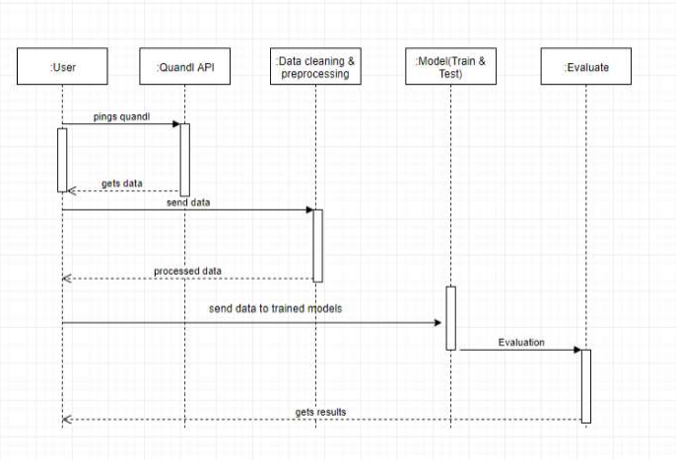
Block Diagram

Slide 9
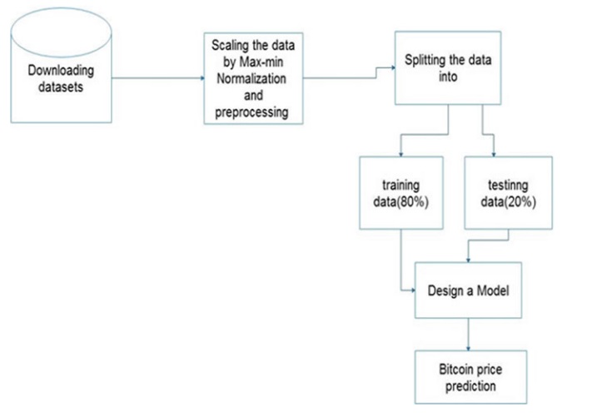
Block Diagram

Slide 10
Project Scope
Attentive : The project will aim to detect a wide range of model graphs, including but not limited to Single platform markups.
Data Sources : The project will consider various sources of platforms, such as Binance, Binamo, and ZDx to develop a comprehensive approach to Prediction.
Real-time Detection : The system will be designed to operate in real-time or near-real-time environments, allowing for timely identification and response to predictions.
Interpretability and Explainability : Efforts will be made to provide insights into the model's decisions, enabling model analysts to understand and validate decisions.

Slide 11
Limitations
Volatility: Discuss Bitcoin's inherent price volatility and the challenges it poses for prediction.
External Factors: Explain how external events (regulations, market sentiment, macroeconomic factors) can impact Bitcoin's price unpredictably.
Data Quality: Mention issues related to data quality and sources in Bitcoin price prediction.
Overfitting: Discuss the risk of overfitting in machine learning models and the need for robust evaluation.
Market Sentiment: Talk about the role of market sentiment and social media in influencing Bitcoin prices.

Slide 12
References
Nakamoto S et al. (2008) Bitcoin: a peer-to-peer electronic cash system, 2008. Working Paper from www.bitcoin.org
Urquhart A (2016) The inefficiency of Bitcoin. Elsevier, pp 80–82
Jang H, Lee J (2017) An empirical study on modeling and prediction of bitcoin prices with bayesian neural networks based on blockchain information. 5427—5437
Dennys CA, Mallqui RAF (2018) Predicting the direction, maximum, minimum and closing prices of daily bitcoin exchange rate using machine learning techniques. Int J Soft Comput (IJSC) 596–606
McNally S, Roche J, Caton S (2018) Cryptocurrency forecasting with deep learning chaotic neural networks. IEEE, pp 339–343

Slide 13
Thank You !

